Slide 1

Project -

Slide 2
Aim :
To design and develop a C++ based Bank Management Application that performs basic banking operations such as account creation, deposit, withdrawal, and balance enquiry using object-oriented programming concepts and file handling for permanent data storage.

Slide 3
Key Features:
1.Create and manage customer bank accounts.
2.Deposit money into existing accounts.
3.Withdraw money from customer accounts.
4.Check account balance and account details.
5.Store customer records permanently using file handling.
6.Menu-driven interface for easy operation.
7.Implementation of object-oriented programming using classes.

Slide 4
Scope of the Project:
The Bank Management Application provides a simple and efficient way to manage customer banking records. It can be used for learning basic banking operations and understanding the concepts of object-oriented programming and file management in C++. The system maintains customer information and transaction details securely within files and can be further enhanced by adding features such as interest calculation, loan management, account transfer, PIN authentication, and transaction history.

Slide 5
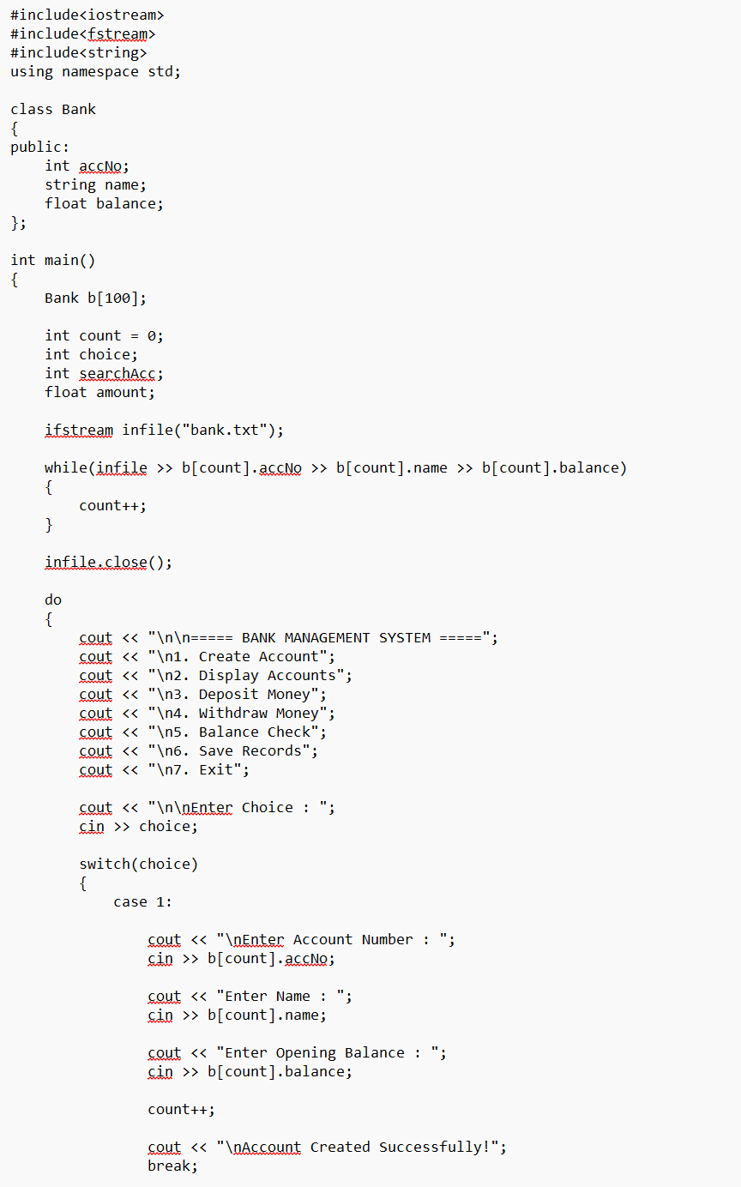
Sample Program:

Slide 6
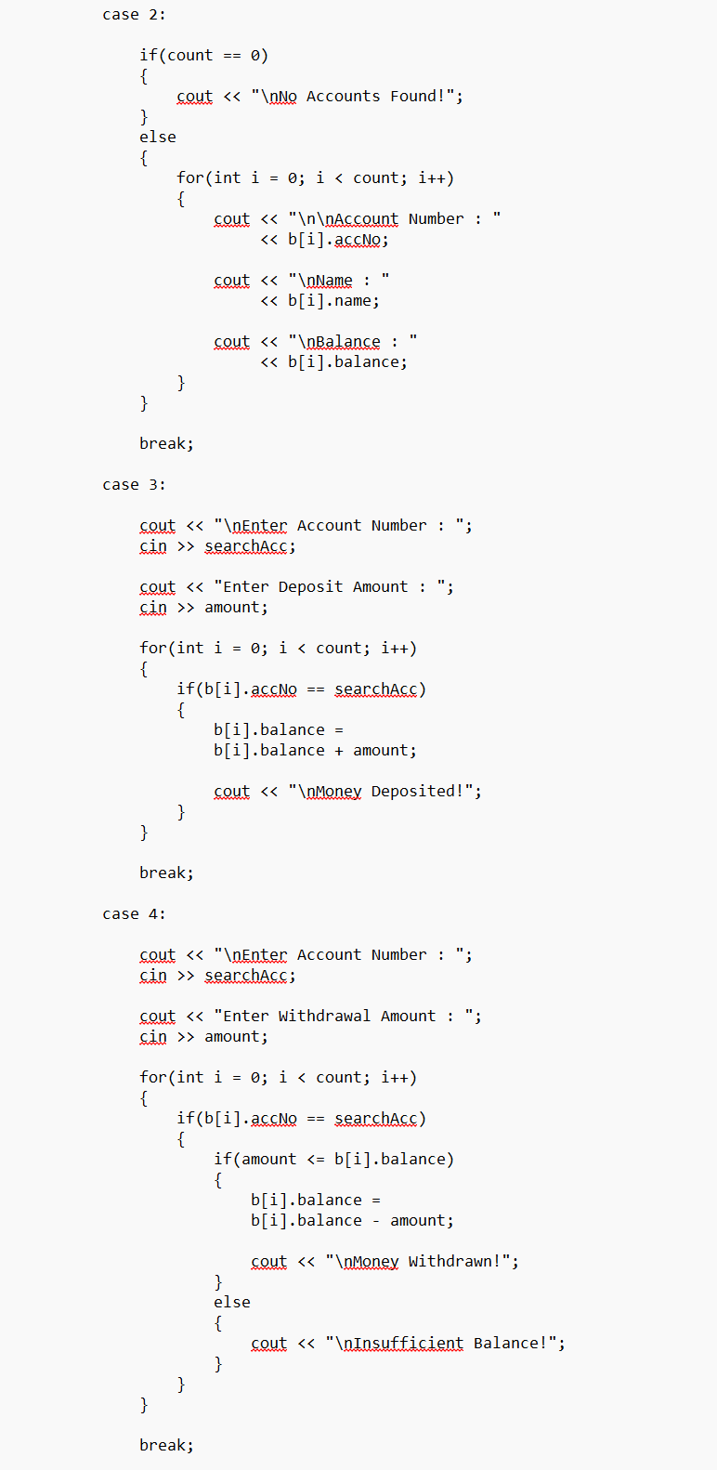

Slide 7
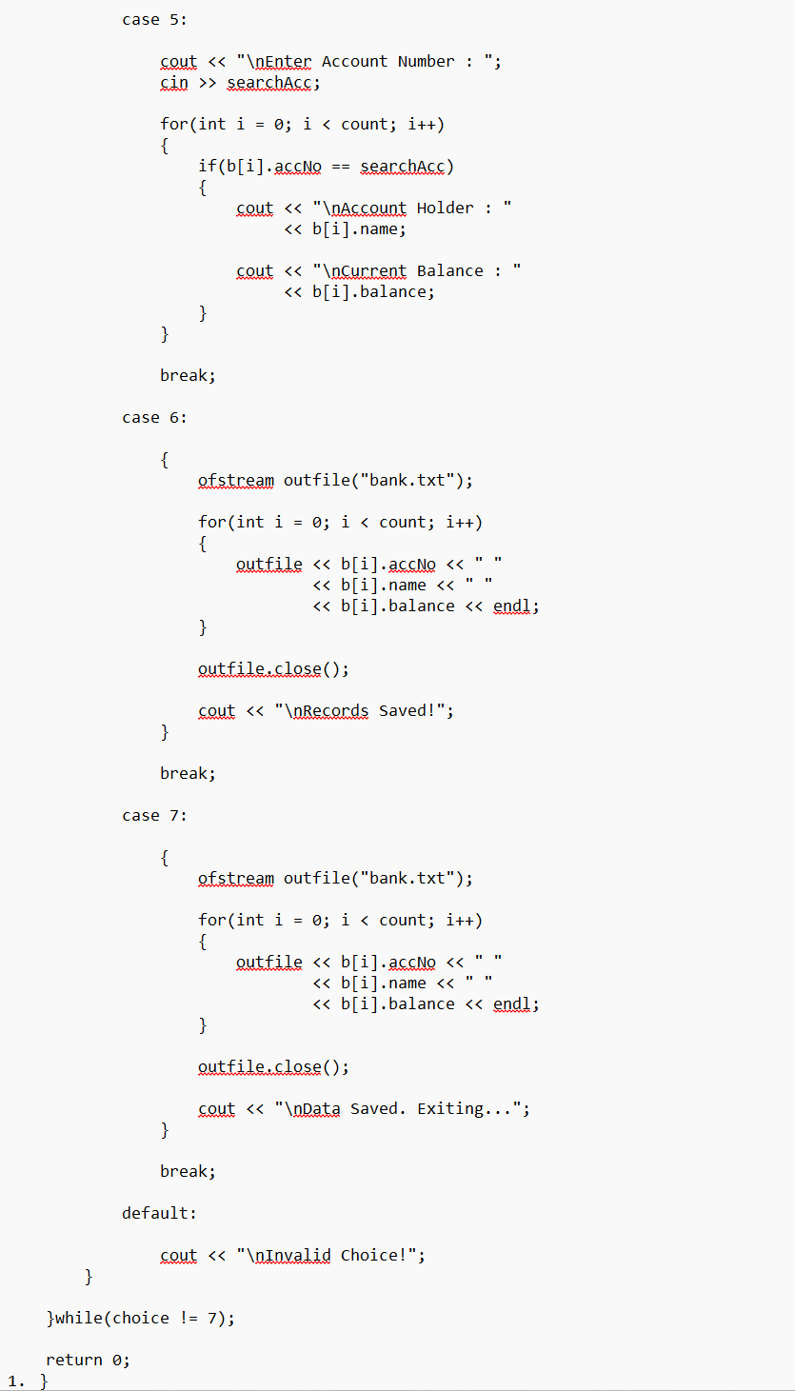

Slide 8
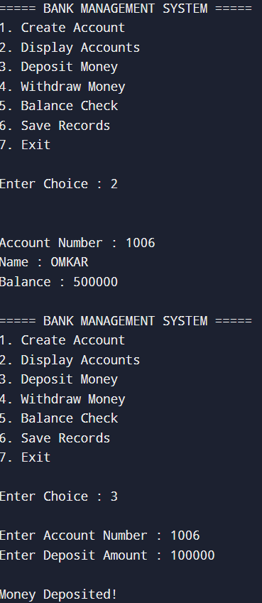
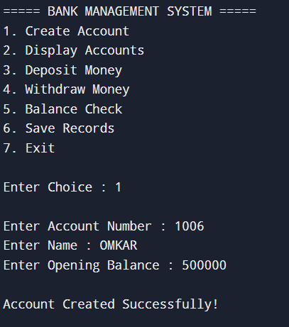
Output:

Slide 9
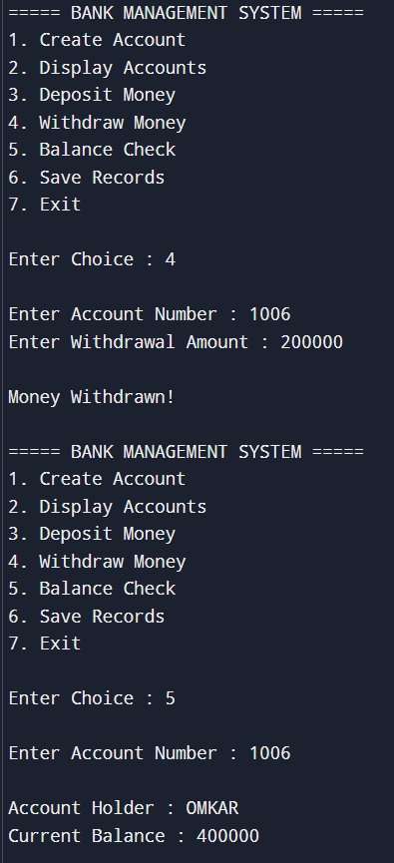
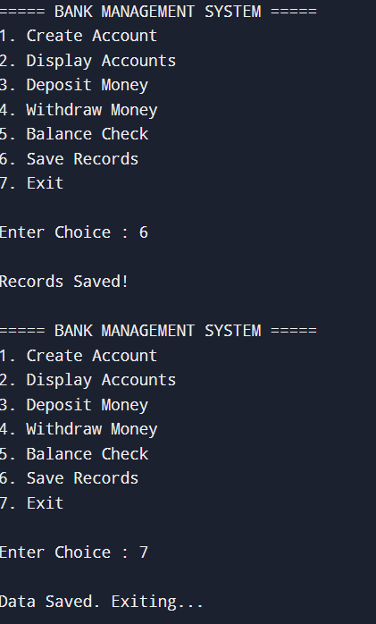

Slide 10
Conclusion:
The Bank Management Application was successfully developed using C++ with object-oriented programming and file handling techniques. The system allows users to create accounts, deposit and withdraw money, and check account balances while maintaining persistent customer records. This project demonstrates the practical implementation of banking operations and provides a strong foundation for developing more advanced banking software systems.

